Slide 1
Project Name:-ACCIDENT EMERGENCY INTELLIGENCE
Created by :- Darshit dobariya , Deep panseriya
- 170160116022 170160116055
- Information technology

Slide 2
work of the project
The system of our project is able to detect the happened accident automatically by itself.
After detecting it will verify if the people present in the particular vehicle are safe or not.
After the verification if the people are not safe the system will automatically call the ambulance.
It will share all the details of the accident including the location using voice call like any other human call.

Slide 3
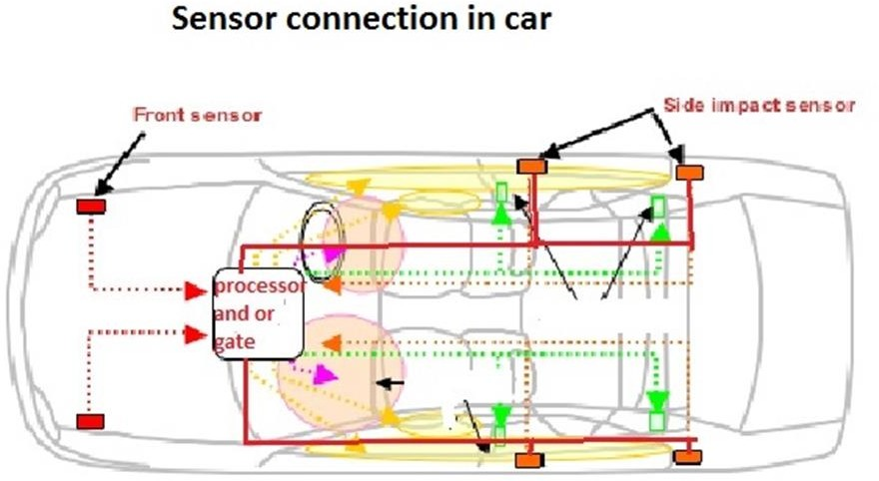
[implementation of shock sensor]

Slide 4
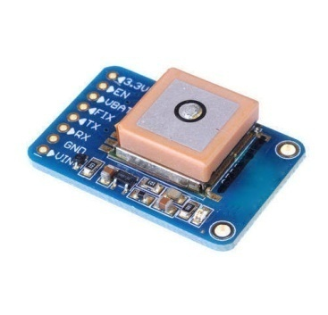
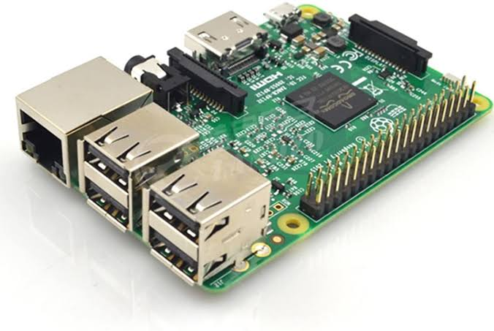

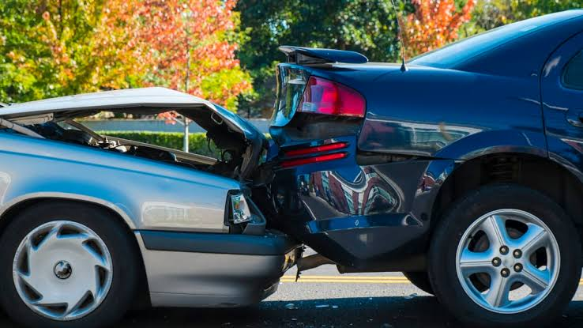
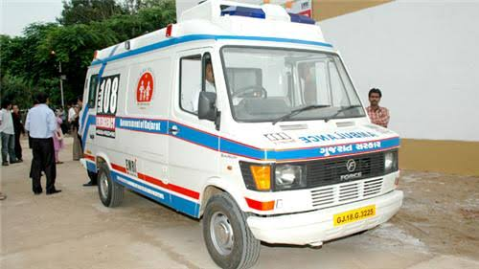
Working of the device
GPS used for
Spot accident
location
3
Our Device
2
Twilo API use
Call Ambulance and share Live Location.
Accident happend between cars
5
Ambulance
1
6

Slide 5
Sensor will detect the accident and will send the command to the device.
After getting command from the sensor device will ask the driver a particular question that ”ARE YOU OKAY ?”
After asking 3 times if there is no response from the driver , our device will contact the twilio api and will share the GPS data.
After getting the data twilio api will call the ambulance in nearest area to share the live location through system generated voice call.

Slide 6
Social Impact of our device
It will immediately call for the help even if there is no human presence on the location which is big advantage of the system.

Slide 7
Hardware and Software Requirement
Hardware:
Raspberry Pi 4B
gps
Gsm Sim900a
Microphone
Speaker
Shock Sensor
Software:
Twilio API
VNC viewer
Putty
python

Slide 8
Our Future Plan
We will try to provide this device in almost every vehicle.
Maximum number of people should be able to take advantage of this device in the future.

Slide 9


